Slide 1
Planning Your Publication
Asking the Right Questions

Slide 2
Asking the right questions before you start working is essential to an effective publication.

Slide 3
Question 1
Who is your target audience?
a specific group of people for which you design your documents; can be categorized by culture, age, gender, income…
Knowing your reader will help you focus your approach to the publication.
Notes:
Talk about specific needs of different groups, i.e. color, fonts, font size.

Slide 4
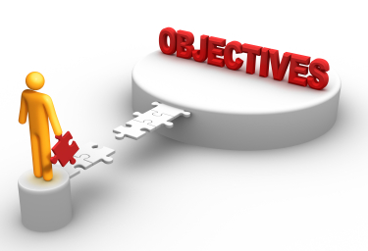
Question 2
What is the purpose of this publication?
To inform, advertise, persuade, entertain . . .
Identifying the objective of the publication will help you narrow your focus.

Slide 5
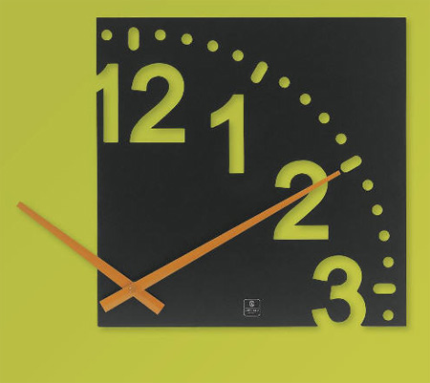
Question 3
What is the time frame for this publication?
Time frame: the amount of time given to complete a document or publication
Factors:
Who will be involved in the publication?
How much time is needed for each phase of the publication, i.e. photography, printing, binding, mailing?
Notes:
Most projects require input from several sources. Consider everyone’s time schedule.
Consider all phases of the production:

Slide 6
Question 4
What is the appropriate layout for this particular publication?
Should the layout be a brochure, booklet, flyer, postcard, poster?
What type of paper? Paper size? Page orientation?
Create a thumbnail sketch: a small sketch that shows only the major elements of the publication
Notes:
Review landscape vs. portrait orientation.

Slide 7
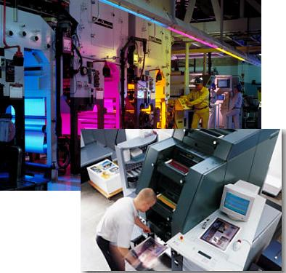
Question 5
What production method will be used?
Professional printer vs. copy center vs. in-house
Will color be a component or will it be printed in black/white?

Slide 8
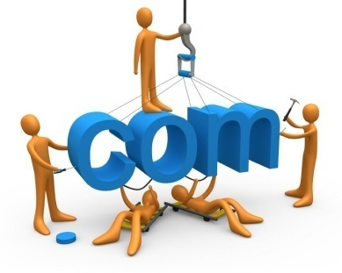
Question 6
What is the delivery method?
Mailed? Direct mail? Bulk mail?
Weight and size of paper affects the cost.
Handouts?
Interoffice communication?
Display rack?
Web posting?

Slide 9
Question 7
Is the budget adequate for this publication?
The answers to all the other questions will determine the cost of the publication: time, type of project, paper, binding, method of printing, color, distribution methods.

