Slide 1
Digital Imaging 101
Ann Ware

Slide 2
Digital Image Categories
BITMAP
VECTOR
A vector is created by using a series of mathematically defined lines and curves rather than pixels
When a vector is resized, the formula is recalculated
The image will have the same quality—no matter what size
Also called draw-type graphics
A bitmap is an image composed of pixels with a fixed resolution
The number of pixels in an image determines the quality of the image (resolution)
Resizing can result in pixelation
A bitmap is also known as a raster graphic

Slide 3
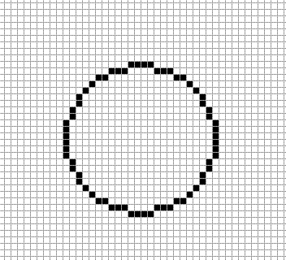
Bitmap
Painted on a grid
Vector
Drawn mathematically
Notes:
Click on the bitmap circle and it will link to the lily. The section enlarged in the corner of the lily is from the center of the lily.

Slide 4
Bitmap Software
Bitmap images can be created with
  a digital camera, scanner, or by using a painting program like Paint, Photoshop.
To edit a bitmap image
  use a digital imaging program like Photoshop, GIMP, Picasa, PhotoScape
  Definition: Painting software — a program used to create bitmap images; useful in creating original art because it provides the tools used by artists (such as brushes and pens)

Slide 5
Most Common Bitmaps
BMP—Bitmap
JPEG—Joint Photographic Experts Group
GIF—Graphics Interchange Format
TIFF—Tagged Image File Format
PNG—Portable Network Graphic

Slide 6
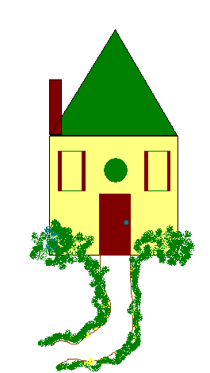
.bmp
Largest graphic file size, generally not compressed
Supports 16.7 million colors
Not appropriate for the web or email attachments

Slide 7
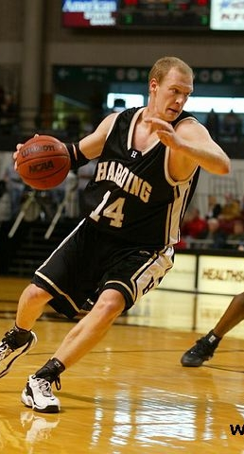
.jpg
Best choice for photos
Compressed file format (lossy)
Supports 16.7 million colors
Does NOT support transparency or animation
Appropriate for web pages
Definition: lossy compression—A compression formula that reduces the size of a file by removing certain pixels.

Slide 8
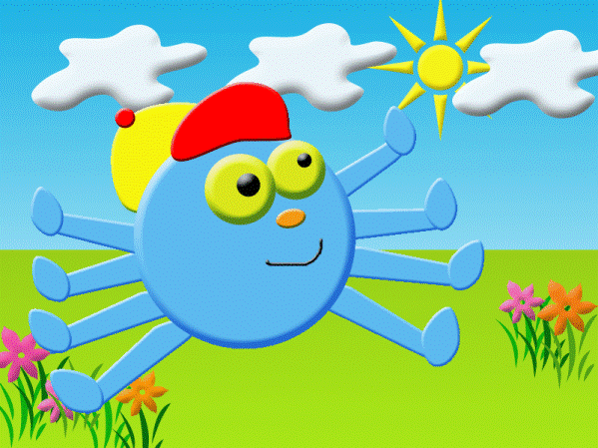
.gif
Compressed file format (lossless)
Supports:
  Transparency
  Animations
  256 colors
Appropriate for web pages
Best choice for graphic images
Definition: lossless compression—a compression formula that reduces the file size without data loss

Slide 9

.tif
Not compressed—large file size
Supports 16.7 million colors
With certain software, TIFF files can support transparency
Does not support animation
Can be used for photographs
Not appropriate for web pages or attachments

Slide 10


.png
Compressed file format (lossless)
Supports:
  16.7 million colors
  Transparency
  Animation
Excellent for photos

Slide 11
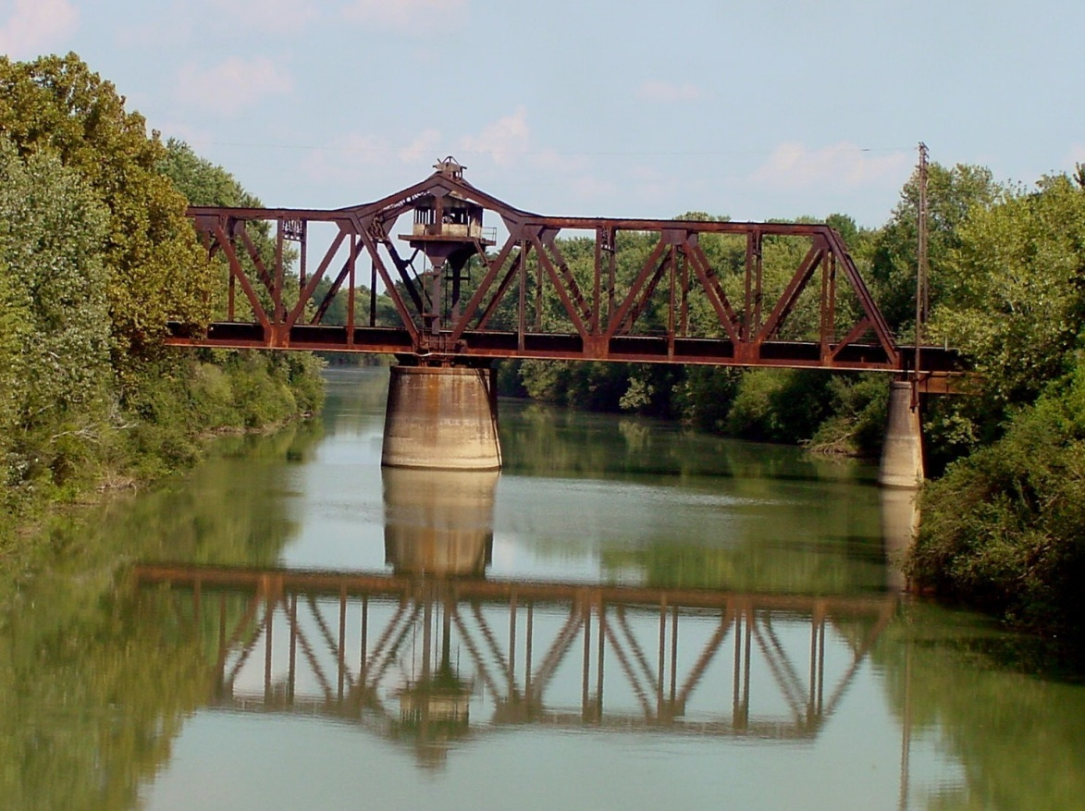
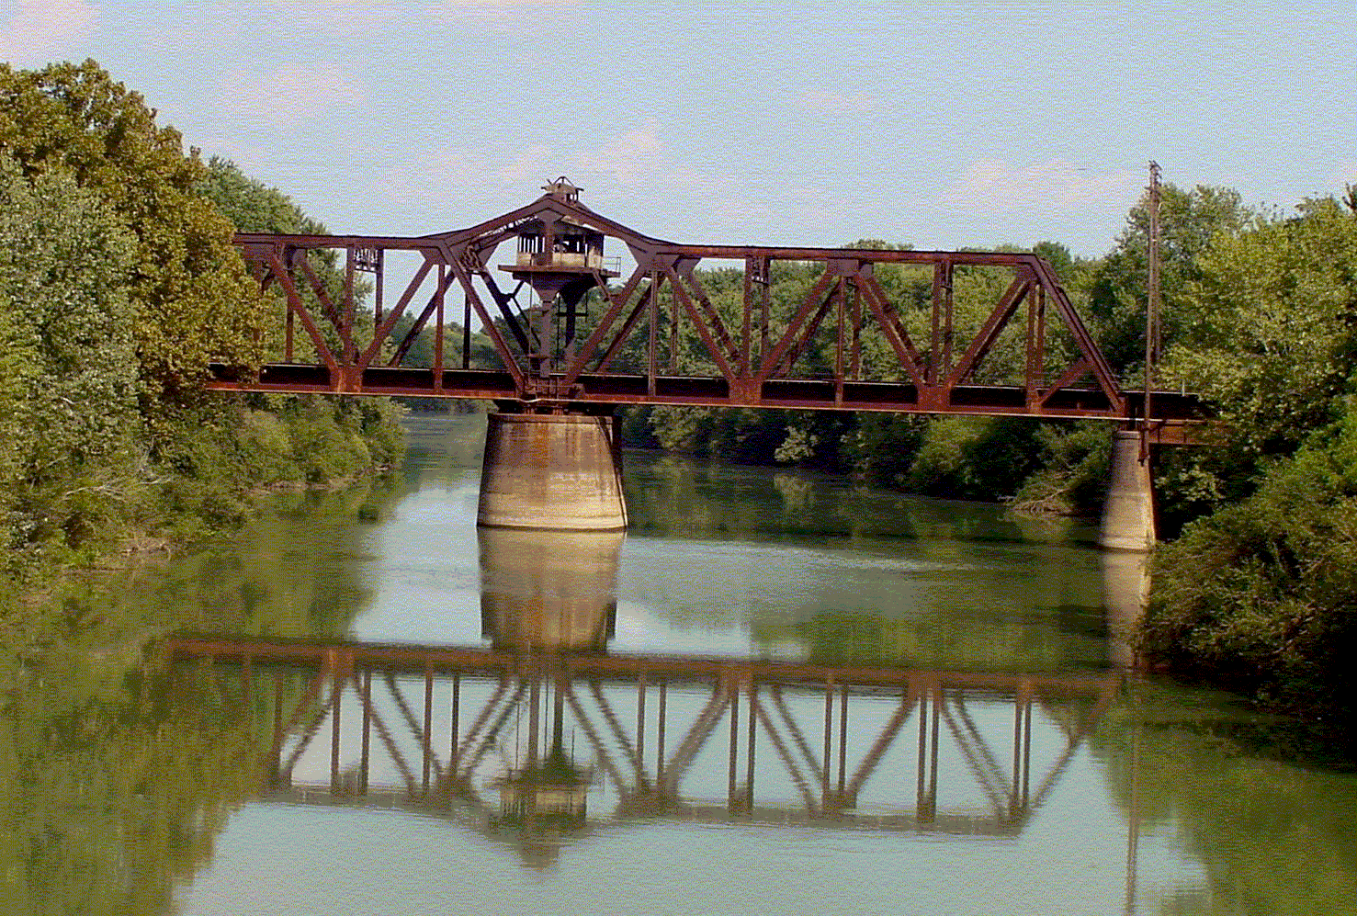


.bmp 4.21 MB
.gif 657 KB
File conversion—The process of saving a file in a different file format than
its current format; example: converting a JPEG to a TIFF
.jpg 360 KB
.tif 4.21 MB
Notes:
This image was saved in four different file formats. Can you tell the difference? The top right file is a gif—notice the difference in the sky color. Gifs can only handle 256 colors. The other file formats can handle 16 million.

Slide 12
Vector Software
Vector software is described as drawing software—vectors are DRAWN, not painted.
  Adobe Illustrator and Corel Draw are drawing programs
Vectors can be created using the drawing/shape tools in Publisher, PowerPoint, Word or PhotoShop.
Definition: Drawing software—a program used to create vector graphics; provides for freehand as well as geometric shapes

Slide 13
Common Vector File Formats
.wmf – Windows Metafile
.ai – Adobe Illustrator
.eps – Encapsulated Postscript
.svg – Scalable Vector Graphic
.pdf – Portable Document Format

Slide 14

Metafiles
Most clip art in the Office gallery are metafiles and have the file extension .wmf
  If you can ungroup an image and edit it, you are probably working with a metafile.
Metafiles are a Microsoft vector image

Slide 15
Other vectors
Times
New
Roman
Graphs / charts (Excel)
Scalable fonts
Times
New
Roman

Slide 16
What does it mean to rasterize a vector?
What does it mean to vectorize a raster?

Slide 17
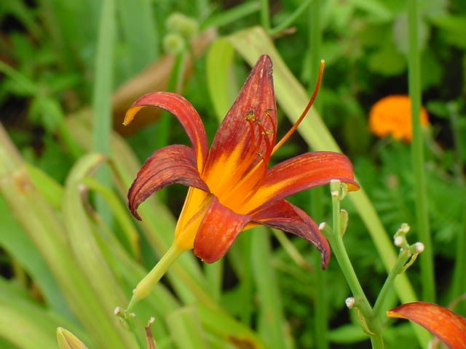

Slide 18
