Slide 1
Design Principles
“The point of design is to encourage and facilitate communication between the viewer and the media being viewed. Effective design initiates this connection by attracting and holding the attention of the viewer through aesthetically satisfying and conceptually intriguing content.”
~Jim Krause, author
Design Basics Index

Slide 2
Design Principles
Definition: guidelines for the arrangement of elements within a production
  In the field of graphic, web, and multimedia design, there is little to no consensus on an exact list of principles. The six principles selected for this unit encompass most of the concepts currently being discussed.

Slide 3
Basic Design Principles
Focal Point
Balance
Visual Flow
Repetition
Contrast
Alignment

Slide 4
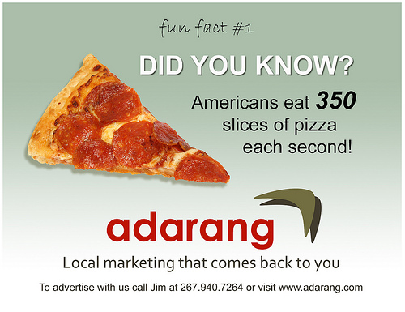
Focal Point
Definition: the visually dominant elements in a presentation; the center of interest
  Other terms:
  geometric center
  optical center

Slide 5
Geometric vs. Optical
Geometric Center—the exact center of the page
Optical Center—the area slightly above and to the right of geometric center; the area that naturally draws the eye to the page; this is the technique used most frequently by designers
Notes:
http://www.artsconnected.org/TOOLKIT/explore.cfm

Slide 6
Geometric vs. Optical
Notes:
Which one do we use the most?

Slide 7

Notes:
Flag—geometric center

Slide 8
Hot Air
Balloon Rides
Call 555-8765
Notes:
Balloon optical center

Slide 9
Balance
Definition: creating equal visual weight to a page design
  Symmetrical or asymmetrical
http://www.artsconnected.org/TOOLKIT/explore.cfm

Slide 10
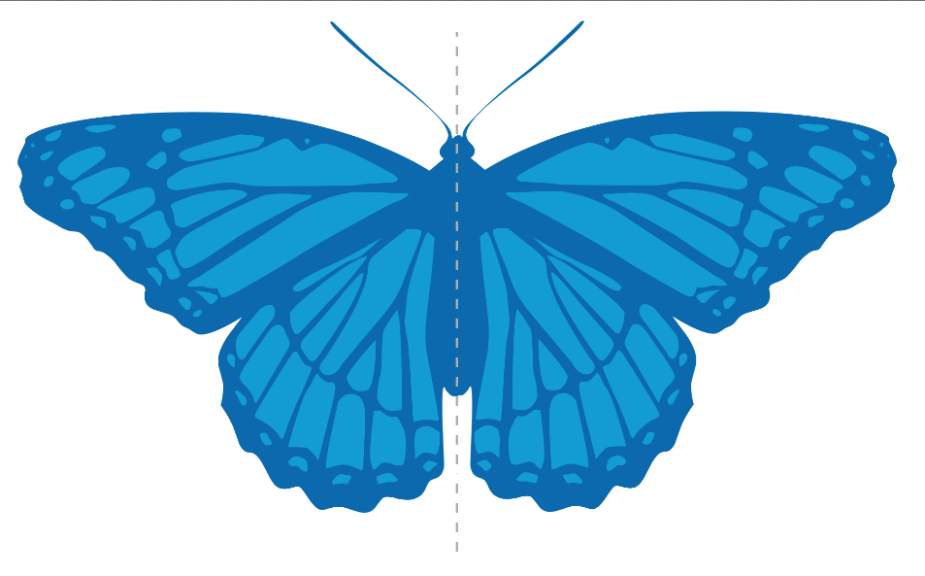
Symmetrical Balance
  Definition: the weight of a composition is evenly distributed around a central vertical or horizontal axis; visual elements are mirrored from side to side or from top to bottom
  Generally lends
  itself to more formal,
  orderly layouts

Slide 11
Symmetrical Balance
Radial Symmetry
Horizontal Symmetry
Approximate Horizontal Symmetry

Slide 12
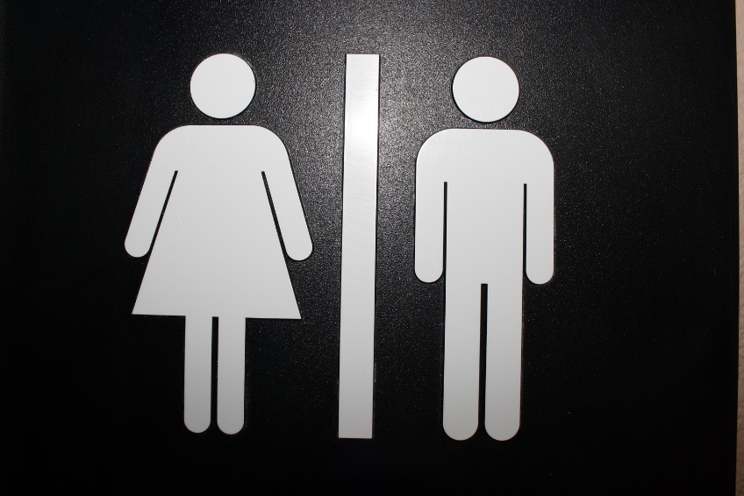
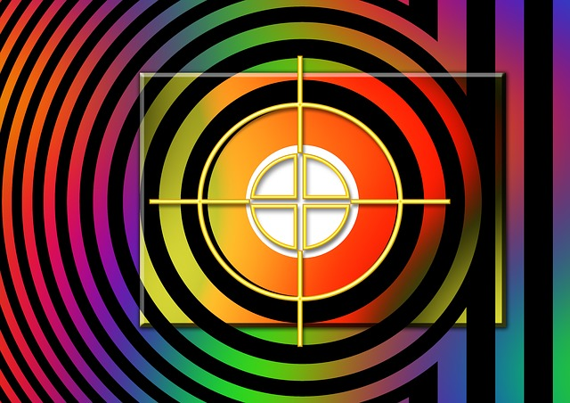
????

Slide 13
Asymmetrical Balance
  Definition: the weight of objects is not identical, but appear to have the same visual weight. Often there is one dominant form that is offset by many smaller forms.
  Can provide a sense of visual tension; also known as informal balance
http://www.digital-web.com/articles/principles_of_design/

Slide 14
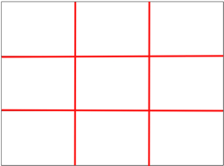
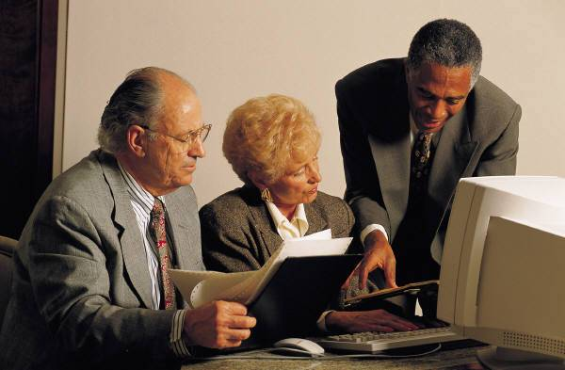
Rule of Thirds
Definition: visually dividing a frame into thirds, either horizontally or vertically
  Points of interest should occur
  at 1/3 or 2/3
The theory is that if you place points of interest in the intersections or along the lines, your photo/page becomes more balanced and will enable a viewer of the image to interact with it more naturally.
http://digital-photography-school.com/blog/rule-of-thirds/

Slide 15
Visual Flow
Definition: the visual path created by the arrangement of elements
Visual flow carries the viewer's eye through the project
  Z-Pattern—the visual path that draws the eye from top left to top right down to bottom left and then to bottom right.
http://webdesign.about.com/od/webdesignbasics/ss/flow-in-design.htm

Slide 16
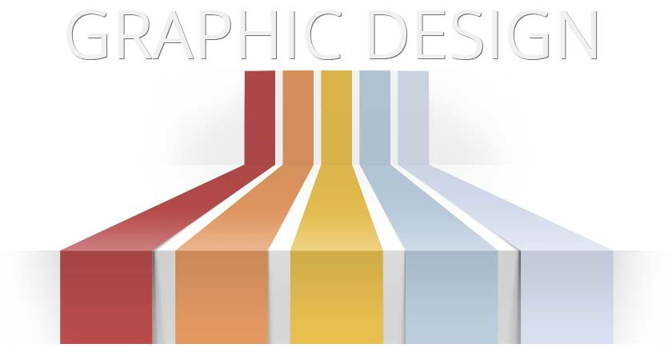
Repetition
Definition: the use of the same visual effect a number of times in the same project.
The consistent repetition of graphic elements works to create visual unity

Slide 17
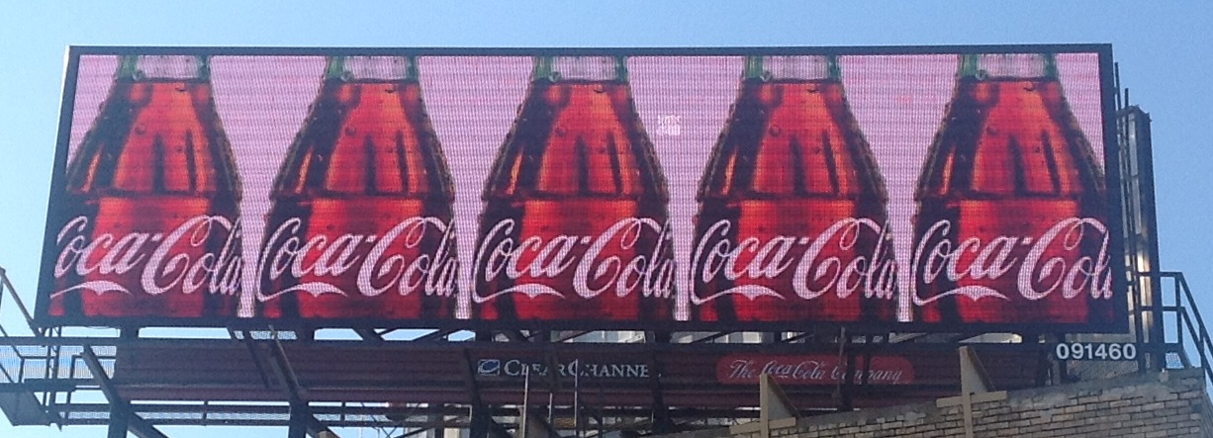
Repetition

Slide 18
Contrast
Contrast occurs when two elements are different. The greater the difference the greater the contrast. Make sure the differences are obvious.
Common methods of creating contrast are by using differences in size, value, color, texture, shapes and type.
Contrast adds interest to the page/frame and provides a means of emphasizing what is important or directing the viewer’s eye.
http://desktoppub.about.com/od/contrast/ss/contrast.htm
Notes:
Notes: The colors in this design template are an example of contrast; The shades of orange are a contrast in color value

Slide 19
For Sale
Office 2003 Textbooks
Tel: 555 555 5555
Notes:
For Sale sign: contrast color and font size
Illustration from Jack and the Beanstalk or David and Goliath: size contrast

Slide 20
Alignment
Alignment: The visual connection among words, shapes, graphics, images and lines on a page/screen when their edges or axes line up (align) with each other.
Text and other objects may be aligned with relation to each other or the page itself.
The proper use of alignment improves the organization and professional appearance of a page
Good alignment is invisible!
Notes:
3.7.1

Slide 21
Alignment
There are several different types of alignment:
  Center
  Edge
    Left
    Right
    Justified
  Visual
  Grid
  Breaking
Notes:
3.7.1

Slide 22
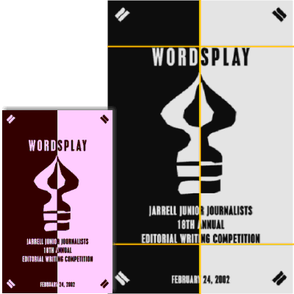
Center Alignment
Center alignment may be horizontally or vertically aligned, or both.
Elements may be centered on the page, within sections of the page, and centered with other elements on the page.

Slide 23
Edge Alignment
Edge alignment lines up text or objects along their top, bottom, left, or right edges.
Left-aligned text (with ragged right edges) is one of the most familiar alignments.
Right alignment generally works best for small bits of text, such as posters, some ads, and small documents like a business card
Justified alignment lines up text on both the left and right edges

Slide 24
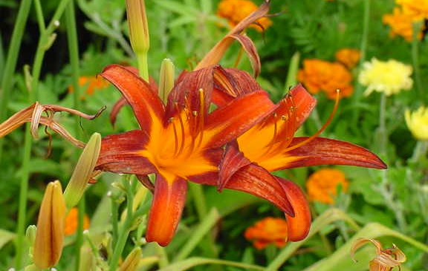
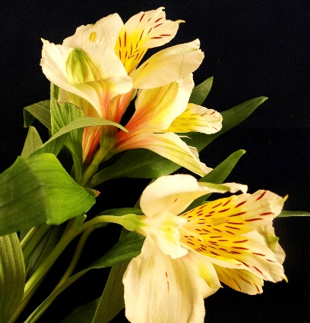
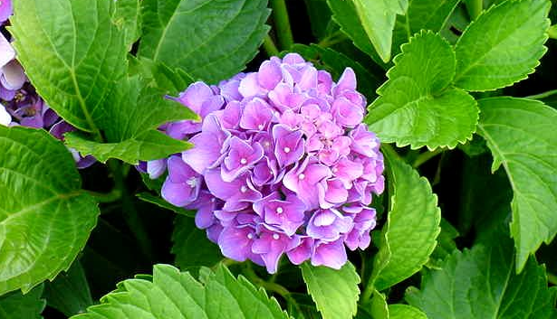
Edge Alignment
“The point of design is to encourage and facilitate communication between the viewer and the media being viewed. Effective design initiates this connection by attracting and holding the attention of the viewer through aesthetically satisfying and conceptually intriguing content.”

Slide 25
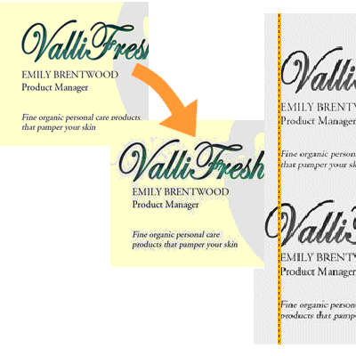
Visual Alignment
Visual alignment:
alignment is not precise,
but appears aligned to
the human eye
This type of alignment can fix
problems that might occur when
the shapes of letters and graphics do
not automatically “fit” each other.
desktoppub.about.com/od/alignment/ss/alignment_6.htm

Slide 26
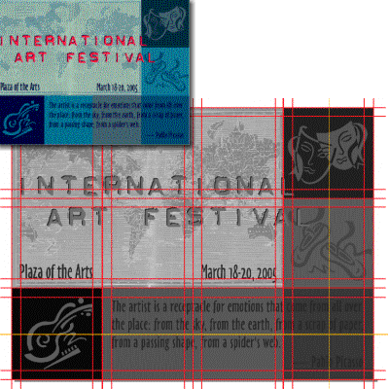
Grid Alignment
Grid alignment: using guidelines and grids to precisely place elements on the page
Use grids to provide page-to-page consistency, unify and align page elements, and provide design continuity across related documents.
desktoppub.about.com/od/alignment/ss/alignment_5.htm

Slide 27
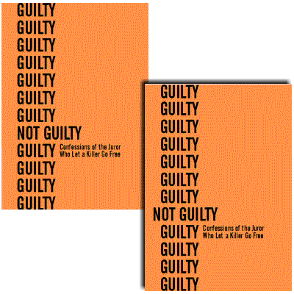
Breaking Alignment
Breaking alignment: intentionally mis-aligning text or an object to create tension or draw attention to a specific element on the page.
Desktoppub.about.com

Slide 28
Creating Unity
Unity is the relationship among the elements of a visual that helps all the parts function together
When unity has been achieved:
  The individual elements within a composition are not competing for attention.
  The key theme will be communicated more clearly.
  The design will evoke a sense of completeness and organization.----in other words, everything “fits”
Notes:
http://graphicdesign.spokanefalls.edu/tutorials/process/designprinciples/unity/unity.htm
http://www.educ.kent.edu/community/vlo/design/principles/unity/index.html

Slide 29
Creating Unity
Some suggestions for creating unity:
  Try repeating colors, shapes, values, textures, or lines to create a visual relationship between the elements. Repetition creates a sense of consistency and completeness. Consistency: maintaining the same layout and style throughout the publication, i.e. fonts, colors, spacing, graphic elements, etc.
  Arrange shapes so that the line or edge of one shape leads into another.
  Group related items together so that the items are seen as one group rather than unrelated elements (proximity).

Slide 30
Design Principles
The principles of design govern how well we communicate the desired message.
By using these guidelines effectively—focal point, balance, visual flow, repetition, contrast, alignment—you can insure the success of your project!
http://karlcleveland.com/151/DesignLecture.htm

