Slide 1
Design Elements
Ann Ware - 2015

Slide 2
Elements of Design
Lines & Shapes | Texture | Value
Mass | Color | Space

Slide 3
Lines
Can be used to divide or unite elements on a page
Can denote direction
Can provide an anchor to hold elements on a page

Slide 4
Lines can be:
Static—uniform spacing
Dynamic—uneven spacing of otherwise uniform lines
Random--freeform

Slide 5
Static Lines

Slide 6
Dynamic

Slide 7
RANDOM

Slide 8
Shapes
Geometric
Natural
Abstract

Slide 9
Geometric
Circle—suggests infinity; free movement

Slide 10
Geometric
Square—denotes honesty and stability; Squares are familiar, trusted shapes.
Because the vast majority of the text we read is set in squares and rectangles, it has become familiar, safe, and comfortable.

Slide 11
Geometric
Triangle--suggests action, movement

Slide 12
Natural
Natural shapes are found in nature or they can be manmade shapes.
Leaves are an example of a natural shape. An ink blob is a natural shape. Natural shapes are often irregular and fluid.

Slide 13
Abstract
Abstract shapes are stylized or simplified versions of natural shapes.
Symbols found on signs, such as the stylized wheelchair shape for handicapped access, is one example.

Slide 14
Mass
Physical—the physical dimension (size) of the paper
      Letter—8.5 x 11
      Tabloid—11 x 17
Visual—the size of each element in relationship to the whole piece
Mass is relative!

Slide 15

Mass is Relative

Slide 16



Slide 17
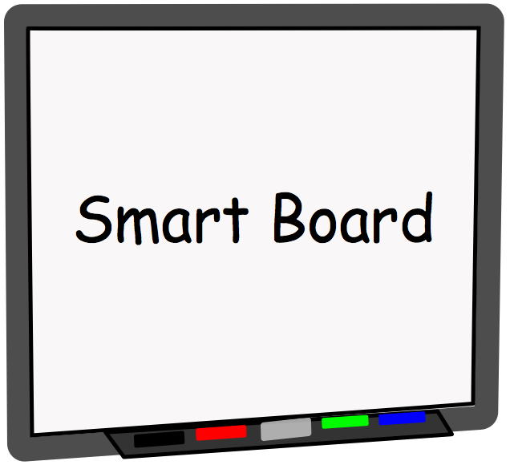


Slide 18




Slide 19
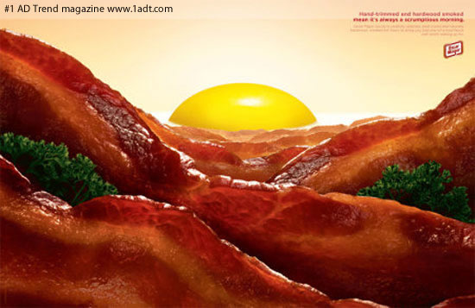

Visual Mass

Slide 20

Texture
Physical—the characteristics of the paper itself; also known as tactile; Examples:
      Glossy
      Matte
      Linen
      Rough—like construction paper, newsprint
Visual—the effects created by photographs or digital images

Slide 21
Color
Color is part of the viewer’s mental response to the light entering the eyes from the display and its surroundings; also known as hue
RGB color (red, green, blue) is the color mode used by monitors; color values range from 0-255
CMYK color (cyan, magenta, yellow, black) is the color mode used by printers; colors are expressed in percentages—0-100%
http://colorusage.arc.nasa.gov/index.php

Slide 22
Important tips on color:
Consider your audience
Use colors appropriate to the topic
Consider color contrast with your background color;
        Older viewers need higher brightness levels to distinguish colors
Use color consistently across the project
Notes:
http://office.microsoft.com/en-us/infopath/HA102270681033.aspx#1
http://colorusage.arc.nasa.gov/index.php
http://www.lighthouse.org/accessibility/effective-color-contrast/
http://www.usask.ca/education/coursework/skaalid/page/scrndsgn/murch.htm
http://desktoppub.about.com/cs/color/a/symbolism.htm

Slide 23
Important tips on color:
Verify that the colors you use look okay on different projection methods; if creating for the web, use web-safe colors
Consider commonly accepted color meanings such as red/yellow are warm, blue/green are cool, red means stop, etc.
        Be sensitive to the fact that colors mean different things in different countries and regions.
Notes:
http://office.microsoft.com/en-us/infopath/HA102270681033.aspx#1
http://colorusage.arc.nasa.gov/index.php
http://www.lighthouse.org/accessibility/effective-color-contrast/
http://www.usask.ca/education/coursework/skaalid/page/scrndsgn/murch.htm
http://desktoppub.about.com/cs/color/a/symbolism.htm

Slide 24
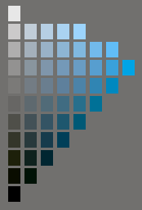
Value
  The measure of darkness and lightness within a color
    Tint—adding white to a hue
    Shade—adding black to a hue

Slide 25
Space
The distance or area between or around elements on the page
Any area that is free from type or graphics is called white space
White space creates a rest for the eye, and visually organizes the elements on the page; also known as negative space.
      It does not necessarily mean the space is white!

