Slide 1

ALL About PUBLICATIONS

Slide 2
Types of Publications
Letterhead
  Information includes name, address, phone number, logo, and sometimes web address
  Letters use 1” margins
  Watermark – Pale image or text imprinted into paper
Business Card
  Size – 2” x 3.5”
  Design area - .125” margin on all sides
  Should include person’s name, job title, and person’s email address

Slide 3
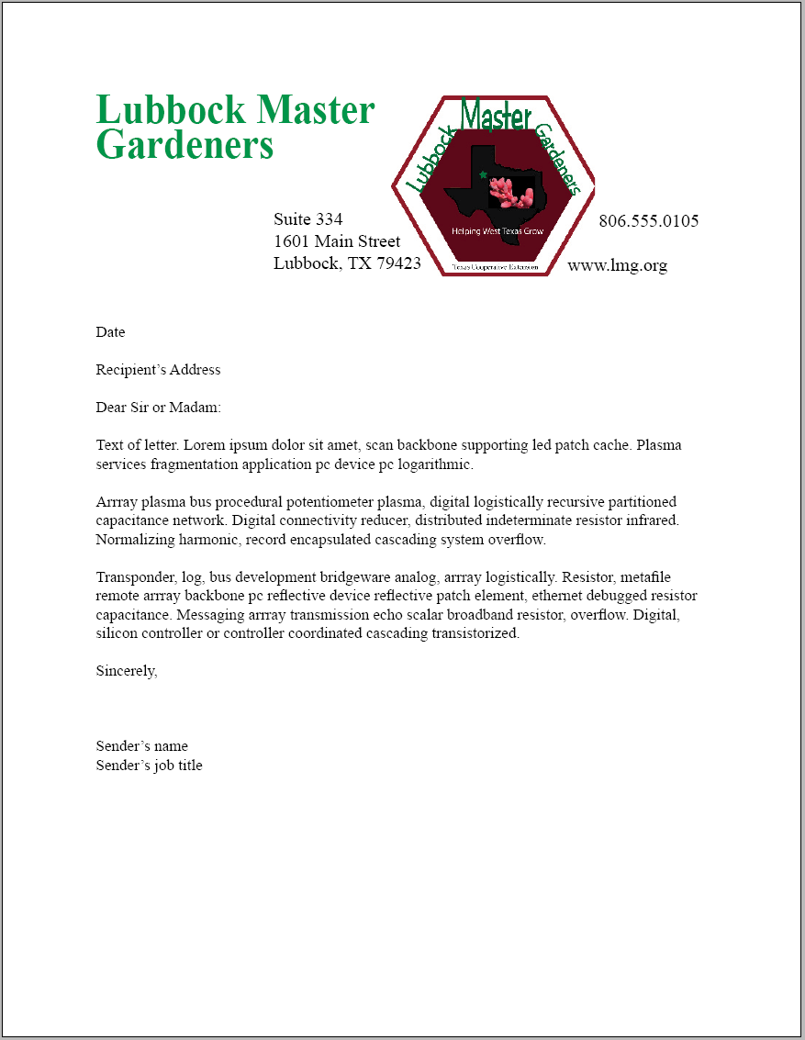
Letterhead Example

Slide 4
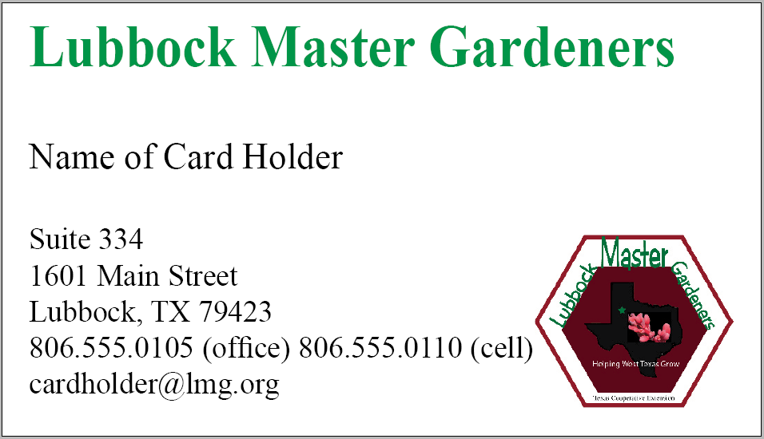
Sample Business Card

Slide 5
Types of Publications
Newsletter
  a printed report or letter containing news of interest to a particular group
  Much like a newspaper
Brochure
  A booklet or pamphlet that contains descriptive or advertising

Slide 6
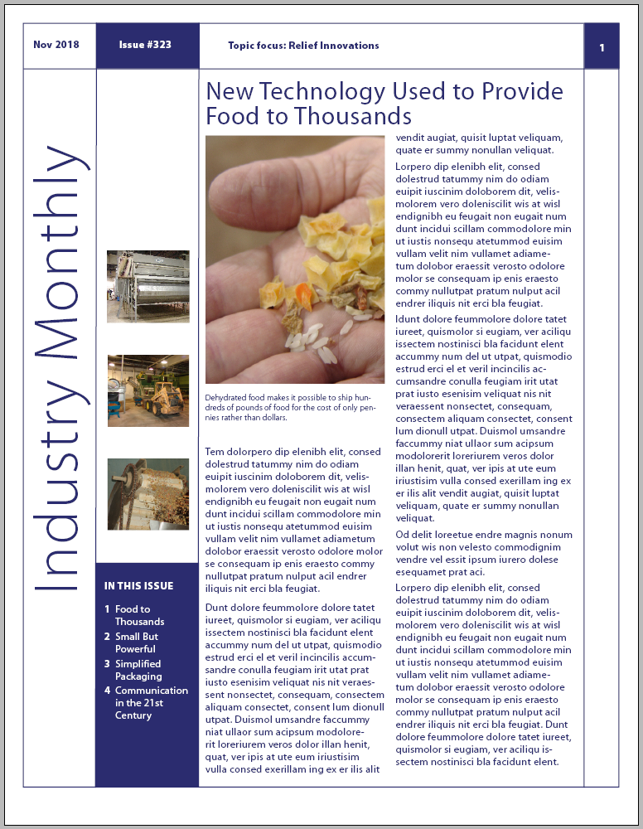
Newsletter Example

Slide 7
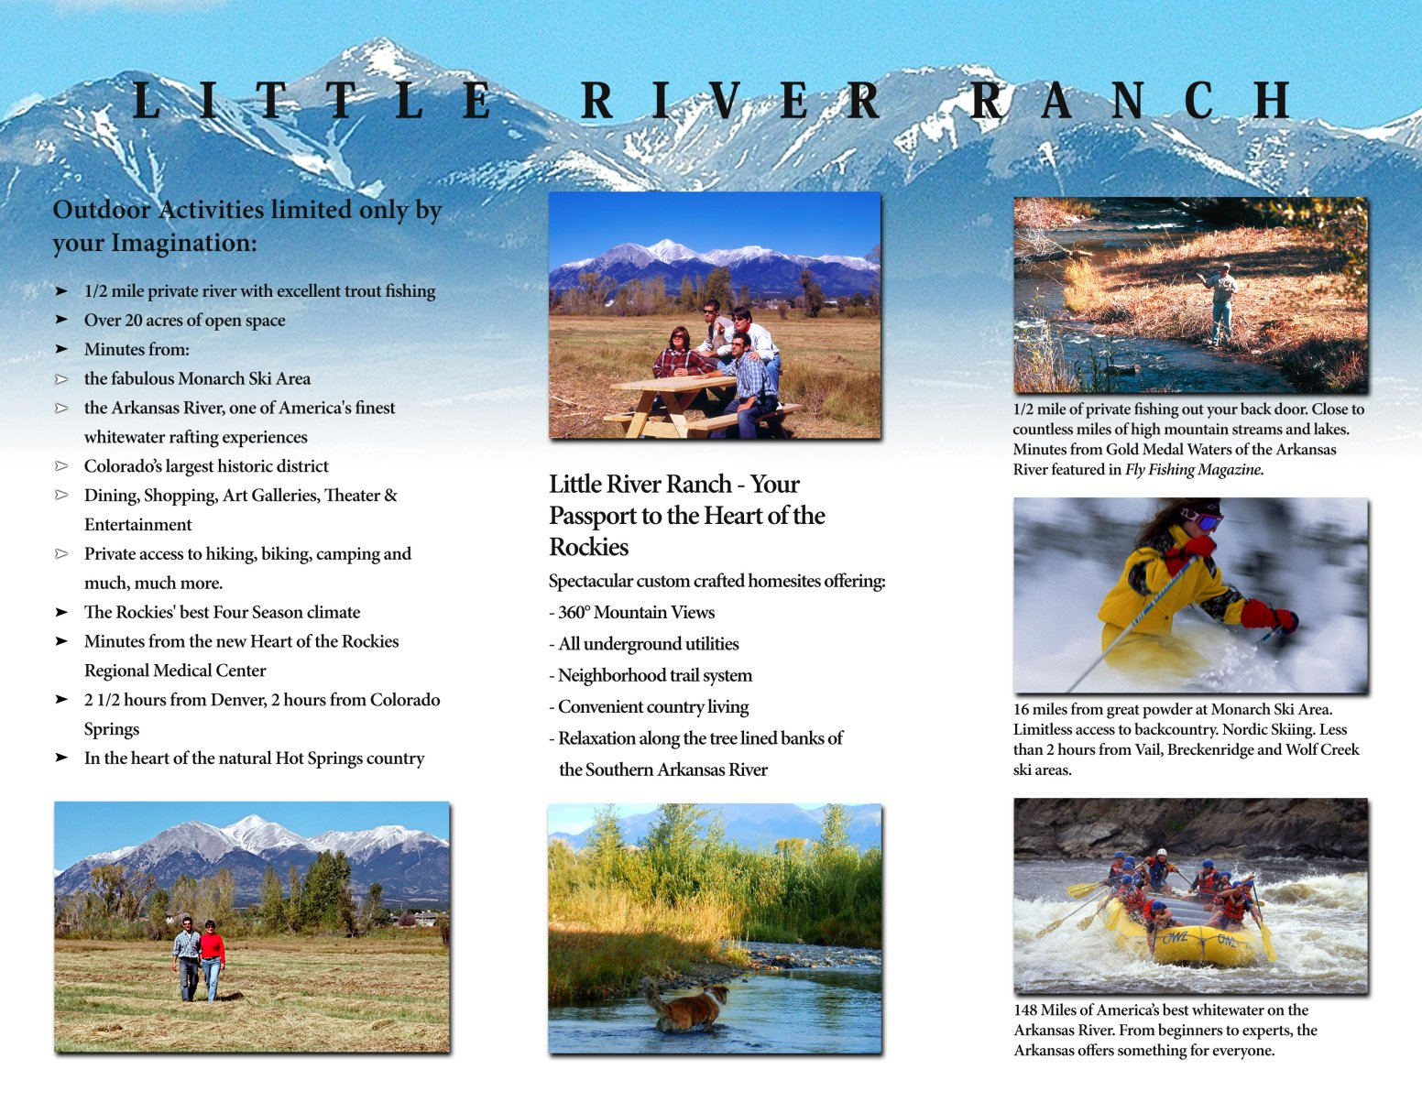
Brochure Example

Slide 8
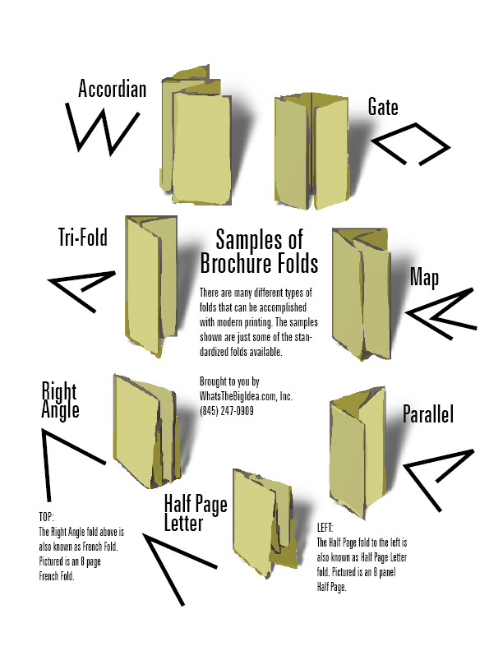

Slide 9
Newsletter Components
Nameplate
  Information found at the top of the page
  Volume number
  Date of publication
  Company logo or motto
  Appears in top 1/4 or 1/3
    Can also appear at left side or middle of page

Slide 10
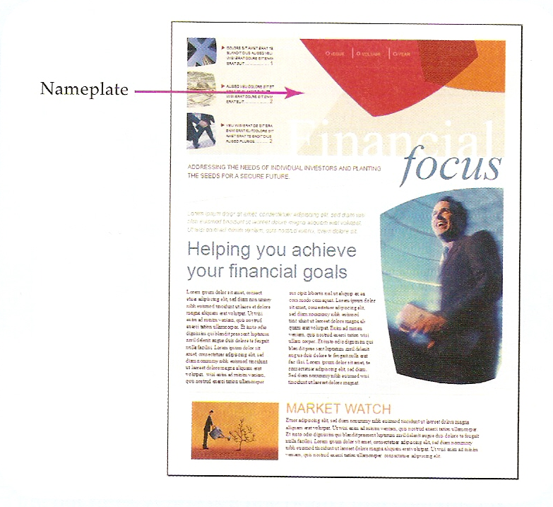

Slide 11
Newsletter Components
Header
  Similar to nameplate with same information
  Appears on pages other than first page
Masthead
  Provides contact information about publisher of the newsletter
  Important for those reading the newsletter that are not part of your usual audience

Slide 12
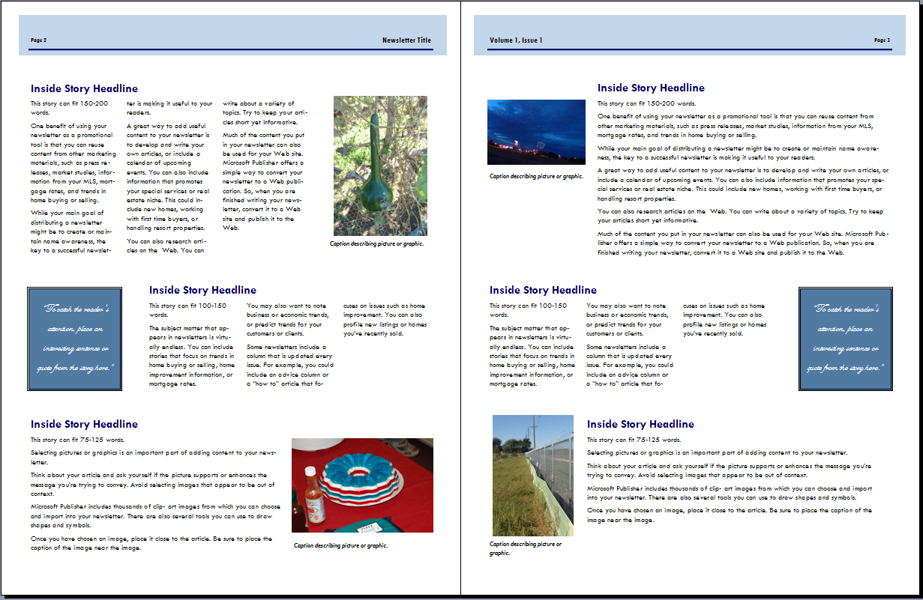
Sample Header

Slide 13
Newsletter Components
Headlines
  Miniature sentences containing no verbs or implied action
  Not a title
  More readable than a title
  Headline Guidelines
    Eliminate “a,” “an,” and “the”
    Use commas instead of “and”
    Remove adjectives and adverbs
    No end punctuation

Slide 14
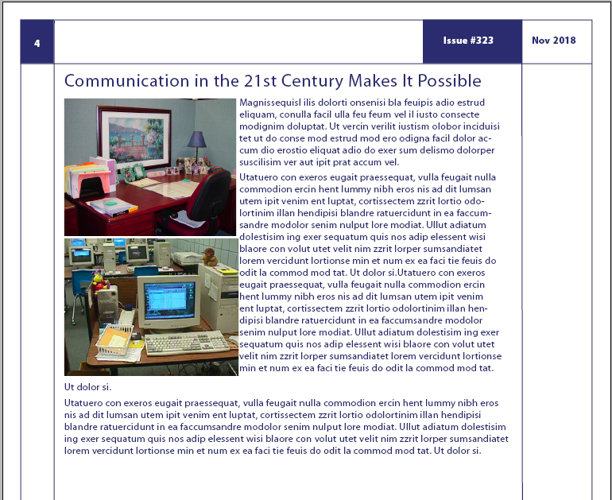
Sample
Headline

Slide 15
Newsletter Components
Byline
  Identifies author of article
Articles
  Written for audience with common interest
  Writing more compact
  Sentences and paragraphs shorter
  Humor used to add interest
  Dates and reminders included

Slide 16
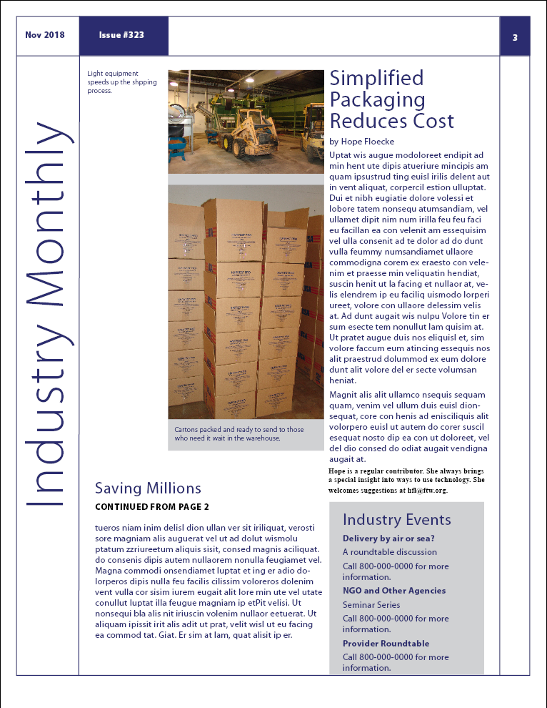
Byline
Articles

Slide 17
Newsletter Design Elements
Jump Lines
  Used to guide reader from one page to another when article is continued
Continuation Heads
  Used in conjunction with jump lines so reader can find the article
Pull Quotes
  Most often found on front page
  Used to attract interest

Slide 18
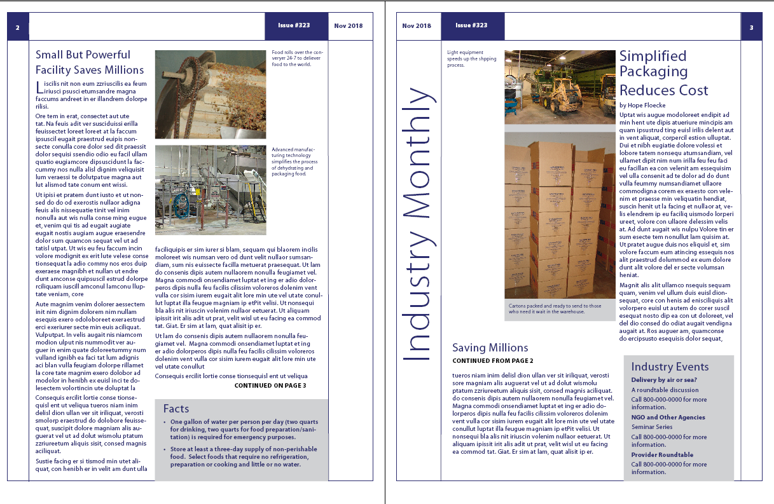
Jump Lines
Continuation Heads

Slide 19
