Slide 1
“There’s a big difference between shooting video and making something that somebody else will want to watch.” ~Colin Barrett
Notes:
Colin Barrett is the author of “Digital Video for Beginners.”

Slide 2
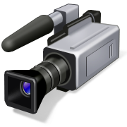
Videography
The process of capturing moving images on electronic media
Also known as video production.
Notes:
Wikipedia.

Slide 3
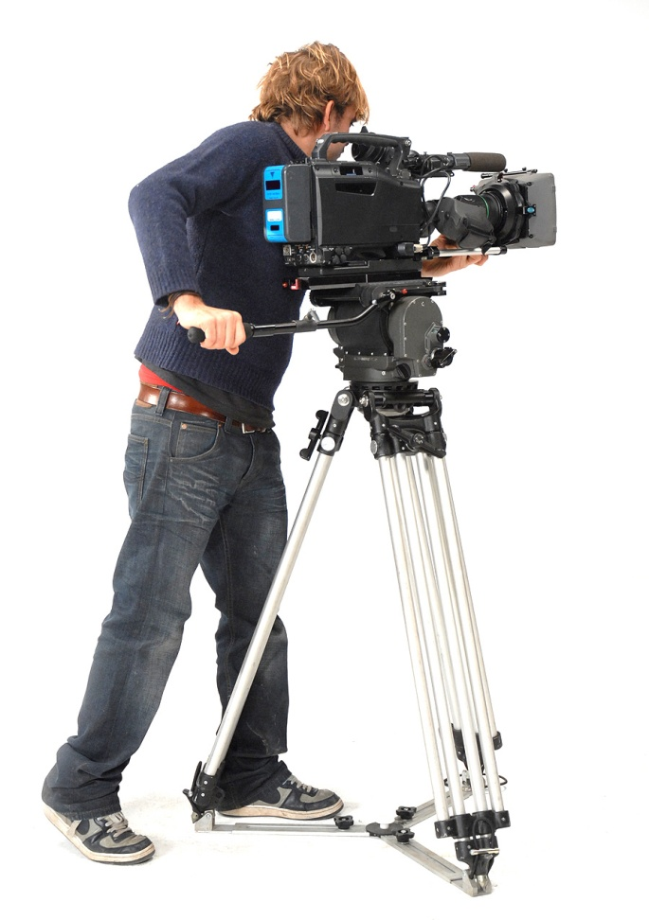
Types of Video Production
Corporate Video
Television Broadcast
Event Video
Marketing Video
Internet Video
Production Training Video

Slide 4
Corporate Video
A corporate video is a video whose purpose is to introduce or present a company in a positive light.
Examples: videotaping conferences and conventions, products and services.
Videos may be broadcast in a variety of ways—within the company, on the web, DVD, etc.

Slide 5
Television Broadcast
ENG—Electronic News Gathering (broadcasting or taping from the site of the news)
EFP—Electronic Field Production (a video production which takes place outside the formal television studio, i.e. sporting events, awards shows, etc.)
Television Video—commercials, infomercials, newscasts, sitcoms, reality shows, etc.

Slide 6
Event Video
An event video can be created from a sporting, school, stage, wedding, church or other similar event.
Most events are recorded and then edited and published at a later time.

Slide 7
Marketing Video
A marketing video is used to promote an organization or product and create an awareness among customers.
Marketing videos range from television advertisements to internet commercials.

Slide 8
Internet Video Production
Videos are the second biggest search engine on the Internet (YouTube)—next to Google searches.

Slide 9
Training Video
Training Videos may be commissioned by an organization to provide instruction for its employees.
Also known as instructional videos, they are available commercially on many subjects
“Freebie” training videos can also be found on YouTube and similar websites.

Slide 10
Careers
The videographer is the actual camera operator or the person in charge of the visual design of a production.
Other careers may include directors, producers, editors, lighting technicians (gaffers), camera operators, sound technicians, animators, multimedia artists, etc.
Notes:
Wikipedia.

Slide 11
Video Settings/Standards
Choosing the proper standards and settings for a video depend upon the video’s destination: DVD, computer, web, etc.
Resolution
Aspect Ratio
Frame Rate
Broadcast Standards

Slide 12
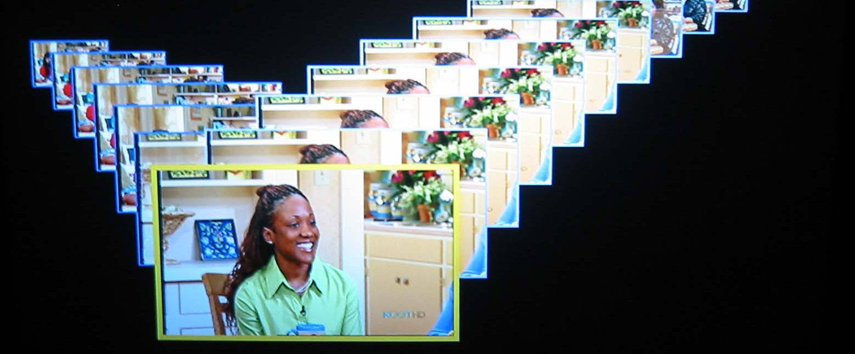
Resolution & Aspect Ratio
Resolution—also known as frame size; refers to the horizontal and vertical dimensions of a frame
DV settings are typically 720x480
http://www.merl.com/areas/timetunnel2/

Slide 13
Aspect Ratio
Aspect ratio—the relationship between the width and height of an image—or horizontal to vertical
4:3—standard television format
16:9—widescreen TV, DVD and high-definition format
21:9—cinemascope (used for theatrical release movies)

Slide 14
Frame Rate
Frame rate—the number of frames recorded per second
The standard frame rate (fps) for video is 29.97. It is sometimes described at 30 fps—but always use 29.97 as the setting in your video software
The fps for animation may be slower or faster, depending on the effect you want
Video game frame rates will vary from game to game

Slide 15
Video Broadcast Standards
NTSC
Most of the Americas & Japan
Uses 4:3 aspect ratio with 29.97 fps
PAL
Most of Europe, except France
Uses 4:3 aspect ratio with 25 fps
SECAM
Brazil, France, southern Europe, Middle East
Uses 4:3 aspect ratio with 25 fps
Notes:
—Each standard is incompatible with each other; Even if video is digital, it still follows a particular format. The director’s chair is a link to a website with more information.

Slide 16
Sources of Material
Use images to create videos
Purchase stock footage (video that is not custom shot for use in a specific film)
Shoot video and capture
Video capture: the process of transferring video to the computer
Notes:
Look for royalty free stock footage libraries; available from a variety of sources. You may find a few free sources.

Slide 17
Software for Video Production
Video Editing
Programs used to capture, edit and manipulate video images, add effects, titles and sound to create studio-quality video
DVD Authoring
Software that will create a DVD that will play in a DVD player
Conversion
Software that can convert a file from one format to another

Slide 18
Software for Video Production
Video Editing
Conversion
Adobe Premiere
Final Cut Pro (Mac)
MovieMaker
iMovie (Mac)
Roxio
AVS
Zamzar
Most video editing software available
today has authoring capabilities.

Slide 19
Common Video File Formats
.wmv—Windows media video
originally designed to play in Windows media player; compressed
.avi—audio video interleave
standard Windows video format; typically uncompressed but has the ability to be compressed
.mpg—motion picture experts group
compressed video format; compressed
.mov—movie
Quicktime video; compressed

Slide 20
Common Video File Formats
.asf—advanced streaming format
Microsoft streaming media format; compressed
.mp4
Mpeg file format used for audio & video streaming; compressed
.vob—video object
DVD video format

Slide 21
Common Video File Formats
.swf
Flash; pronounced swiff; compressed
.m4v
iMovie – iTunes; compressed
.flv
Flash – common with YouTube videos; compressed

Slide 22
Video Cameras
HDD—takes directly to an internal hard drive.
Mini-DV—records video to a small tape; 30-60 minutes recording time per tape
Mini-DVD—records to mini DVD; good if you don’t plan to edit
Flash drive/memory card—records to flash device
Hybrid—combines two methods of storage on one camera
Notes:
If you have time, let students research various brands, prices, etcs.

Slide 23
Anatomy of a camcorder
On/off switch, record/playback, zoom, storage option (tape, dvd, flash, etc.), LCD screen, volume controls, microphone, power source, menu, cables and ports
Tripod bush: the screw-like socket on the bottom of the camera that connects to the tripod
Accessory shoe: the connection on the top of the camera for a light or microphone
Hot shoe: an accessory shoe that is powered from the camera’s battery
Notes:
Have students identify parts of the camcorder;
Tripod bush: threaded socket on the bottom of the camera
Accessory shoe: option on the top of the camera that allows you to connect an external light or microphone
Hot shoe: accessory shoe that allows the accessory to access the camera’s battery for power

Slide 24
Accessories
External microphone
Shotgun—attached to the top of the camera
Handheld--connected to the camera
Lavalier or clip-on—may be wired or wireless
Boom—a directional mic attached to a mechanical arm (boom) that is positioned out of camera range
Wireless microphones
Notes:
Discuss monopods, also.

Slide 25
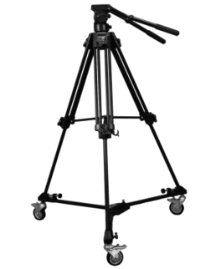
Accessories
Tripod
Select a tripod that will support the weight of your camera
Pan and tilt heads are helpful
Dolly
A rolling base for a tripod

Slide 26
Accessories
Lights
Mounted
External
Chroma Key Backdrop
A video technique that shoots footage against a solid color screen (usually green or blue), which is subsequently removed and replaced with a different background

Slide 27
Connecting to Computer
USB 2.0 capture device
can connect camera or VCR to computer
Firewire (IEEE-1394)
most cameras will have DV out option (excellent quality)
Firewire 400 – PC; Firewire 800 – Mac
Video capture card
optional type of video card that will allow you to connect your camera to the computer by S-Video or composite (red/yellow/white) cables

Slide 28
Camera Techniques
Shots
Angles
Movement
Extreme close-up
Close-up
Mid
Long
Establishing
Low
High
Eye-level
Bird’s eye
Over-the-shoulder
Panning
Tilting
Zooming
Cut (cutaway)
Cut (cutaway)
Notes:
Use www.mediacollege.com for definitions

Slide 29
Camera Techniques
Establishing shot
Usually the first shot of a scene; designed to show the audience where the action is taking place
Low angle
Shows the subject from below—the camera is angled up towards the subject
High angle
Shows the subject from above—the camera is angled down towards the subject
Notes:
Use www.mediacollege.com for definitions

Slide 30
Camera Techniques
Eye-level
Shows the subject as we would expect to see it in real life—from a natural perspective
Bird’s eye
A scene shot from directly above the action
Over-the-shoulder
A camera angle that looks at the talking subject from the listener’s perspective (literally, over the shoulder)
Notes:
Use www.mediacollege.com for definitions

Slide 31
Camera Techniques
Panning
A camera movement that scans a scene horizontally
Tilting
A camera movement that scans a scene vertically
Zooming
Altering the lens to make the subject appear closer or further away
Cut
A quick move from one scene to another; also called a cutaway

Slide 32
Camera Tips
Avoid shooting into the light
Most cameras have “backlight compensation”
Follow the “rule of thirds” guideline:
Points (or lines) of interest should occur at 1/3 or 2/3 of the way up (or across) the frame, rather than in the center of the frame
Leave plenty of recording time at the beginning to allow room for editing

Slide 33
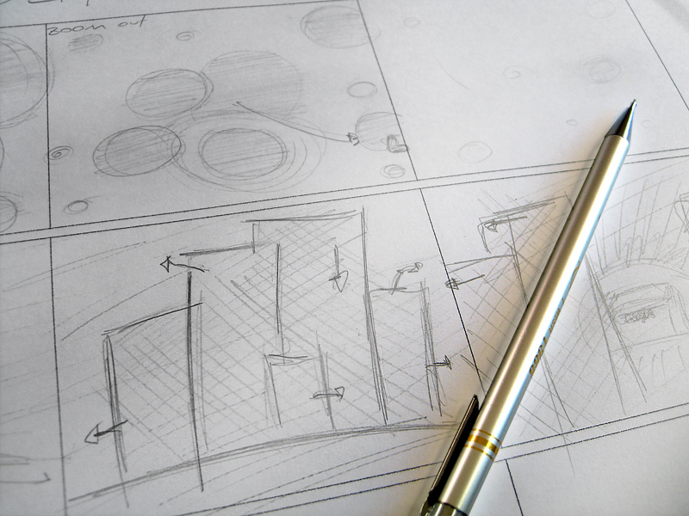
Pre-Production (Plan the Shoot)
Pre-Production: the process of preparing all the elements of a video production
List materials, location, camera angles, etc.
Get approval, if required
Storyboard the idea
A series of sketches that are used as a planning tool to visually show how the action of a story unfolds.

Slide 34
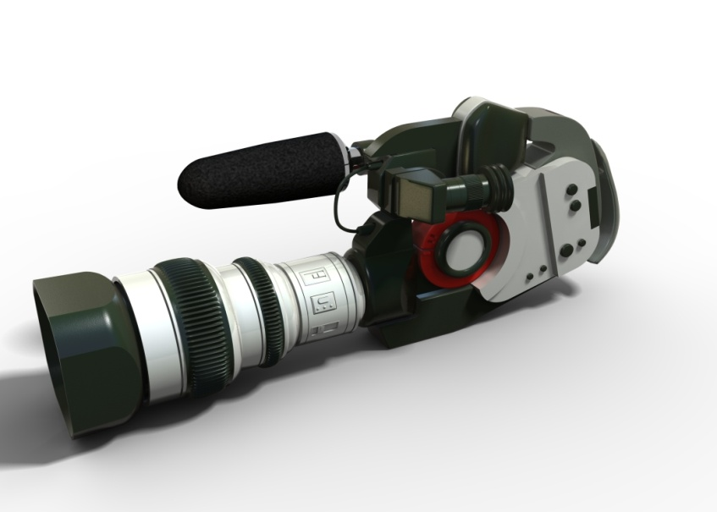
Pre-Production (Cont’d)
Write the script (the spoken text of a video production)
Prepare the equipment
Check storage media, batteries, tripod, etc.

Slide 35
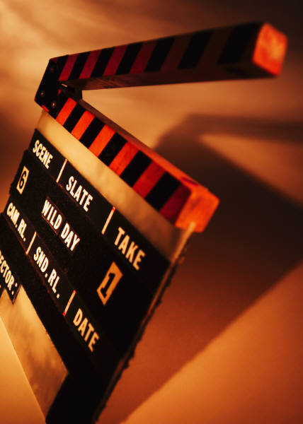
Production
Production: the process of recording the footage
Footage: raw, unedited material as it is originally recorded
Using your storyboard as a guideline, shoot the footage
Shoot B-roll (cutaway) shots

Slide 36
Post Production
Post-Production: all phases following the recording of video
Capture the video--These steps will be dependent on the type of video camera used
Edit the video
Add titles, transitions, audio, etc.
Export the video: The process of converting project files into one file such as an .avi, wmv, mpg, m4v, etc.

Slide 37
Post Production
Record the video to external storage
Copy video to flash drive, CD, etc.
Make a DVD movie using DVD authoring software
Cleanup
Delete footage from computer
Depending on storage media, reformat or erase footage

