Slide 1
Current and emerging Technologies
Ann Ware

Slide 2
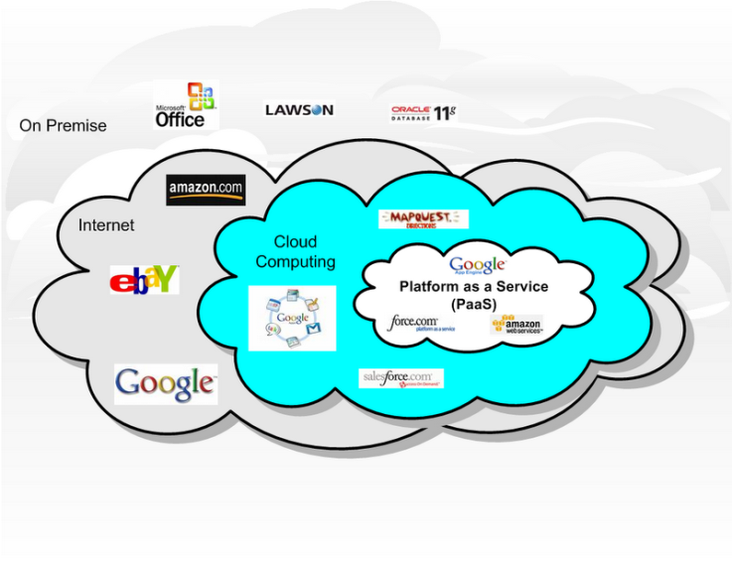
Cloud Computing
The term “cloud” simply refers to the Internet.
Cloud computing is Internet-based computing, where shared resources, software and information are provided to computers and other devices on-demand, like electricity

Slide 3
Cloud Computing – Web-Based Applications

Slide 4
Social Network Sites (SNS)
A website where one connects with those sharing personal or professional interests
Notes:
*http://jcmc.indiana.edu/vol13/issue1/boyd.ellison.html

Slide 5
Online Learning System
An Online Learning System is a virtual learning environment which is readily available for distribution on the Web or privately over an internal network.
Most common are Blackboard, WebCT, Moodle
Notes:
Moodle is free.

Slide 6
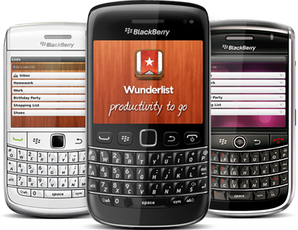
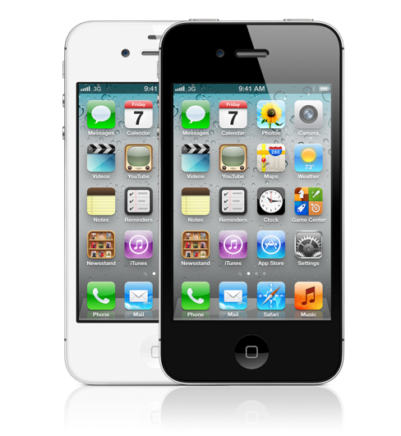
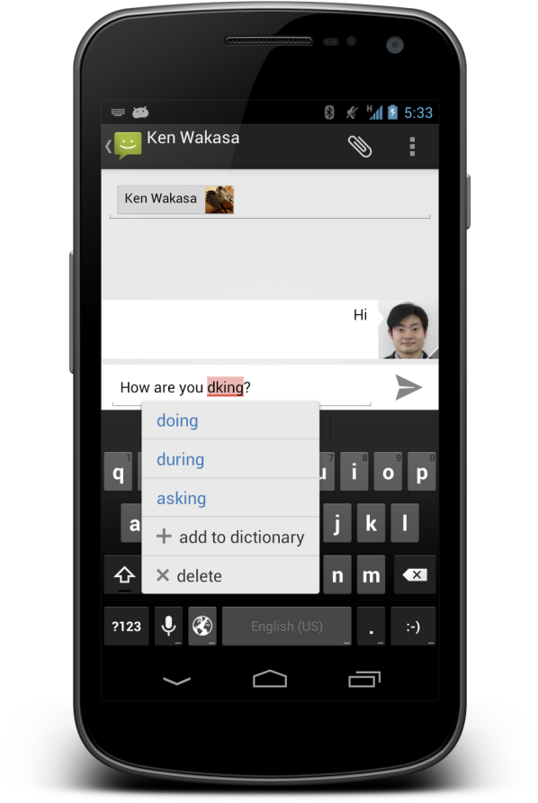
Smart Phones

Slide 7
Podcasts
Podcasting 101
Podcasting tools
Podcasting—About.com
Podcasting—How Stuff Works
Podcasting is a free service that allows Internet users to pull audio files from a podcasting Web site to listen to on their computers or personal digital audio players. The term comes from a combination of the words iPod and broadcasting. Even though the term is derived from the iPod, you don't need an iPod to listen to a podcast. You can use virtually any portable media player or your computer.

Slide 8
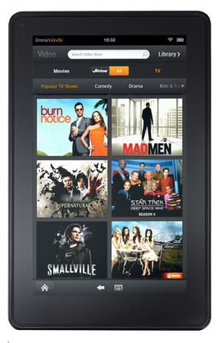
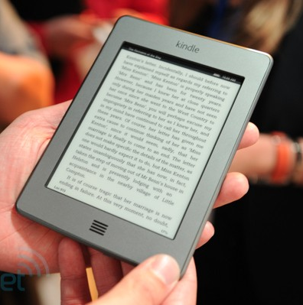
E-Reader

Slide 9
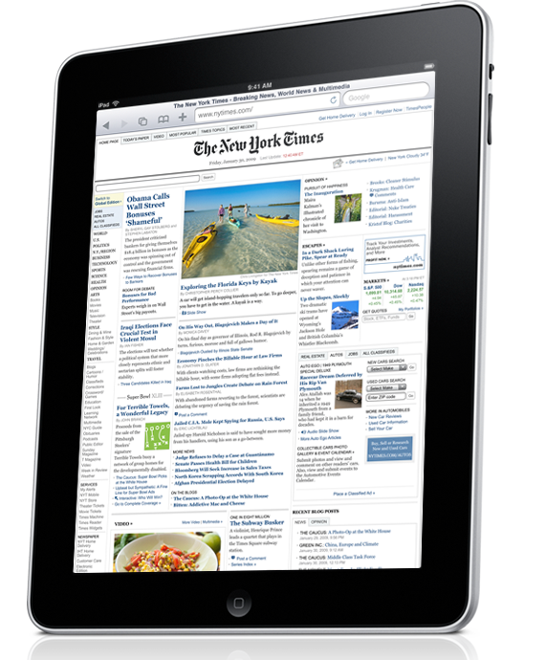
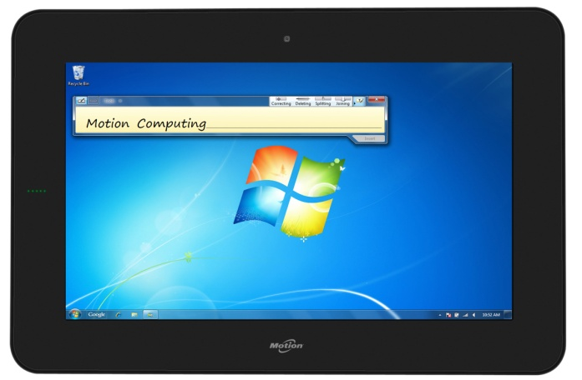
Tablets

Slide 10
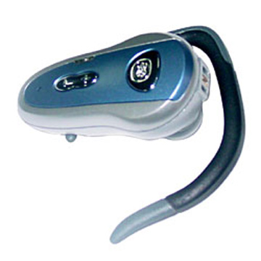
Bluetooth
Bluetooth—About.com
Bluetooth.com (fast facts)
How Bluetooth Works“—How Stuff Works
Definition: Bluetooth technology is a wireless protocol that connects electronic devices while they are in close vicinity of one another. Instead of creating a local-area network (LAN) or a wide-area network (WAN), Bluetooth creates a personal-area network (PAN) just for you.

Slide 11
Apps (Applications)
Software suitable for use on portable media devices
Portableapps.com
Accessibility
Development
Education
Games
Graphics & Pictures
Internet
Music & Video
Office
Operating Systems
Utilities

Slide 12
Video Chat
Free internet to internet video calls

Slide 13
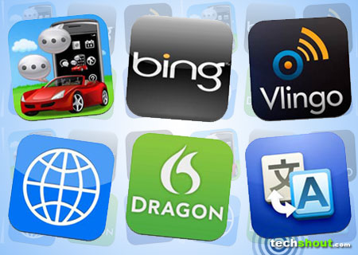
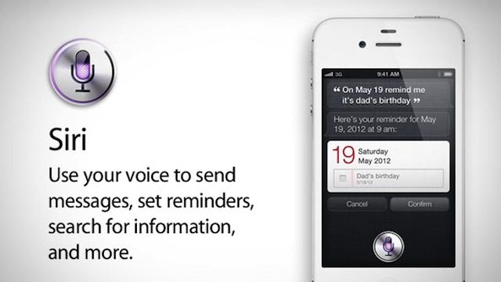
Voice Recognition
The processor breaks down spoken words into sound waves and uses algorithms to identify the most likely words formed by the sounds.
Software is available for computer systems as well as mobile apps.

Slide 14
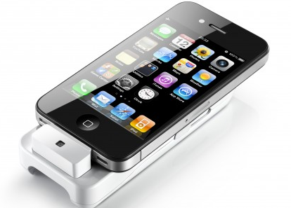
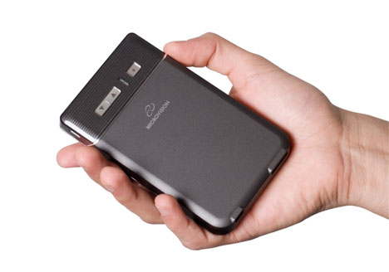
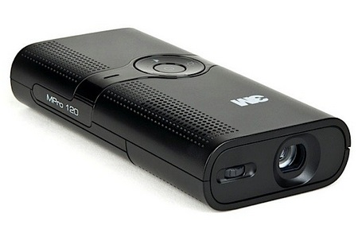
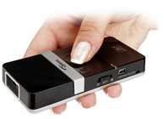
Pico Projector
A pico projector will fit in the palm of your hand.
Notes:
Top right is iPico for the iPhone.

Slide 15
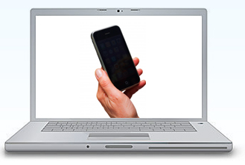
Near Field Communications
NFC is a form of contactless communication between devices like smartphones or tablets.
`It allows a user to wave the smartphone over a NFC-compatible device to send information without needing to touch the devices together or go through multiple steps setting up a connection.
Example:
Wave and pay . . . at stores, public transportation, etc.
Wave and listen . . . Museums, amusement parks, etc.
Notes:
http://www.itbusinessedge.com/slideshows/show.aspx?c=93073&slide=5

Slide 16
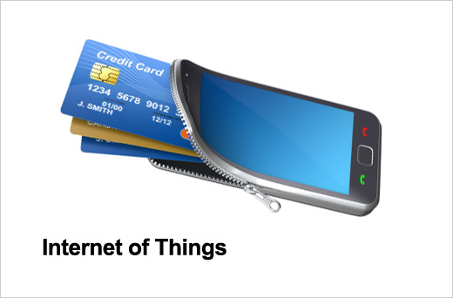
Image Recognition
Image recognition allows the user to scan (take a picture) of an object, people, buildings, logos, etc. and the technology will search the Internet to identify the scanned image.
Application for retail businesses: A user could scan a particular type of shoe and the device would locate the nearest stores where it could be purchased.
Notes:
http://www.itbusinessedge.com/slideshows/show.aspx?c=93073&slide=5

Slide 17
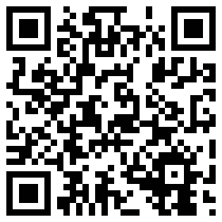
QR Codes (Quick Response)
QR codes are two-dimensional bar codes
The codes can contain many different types of data. Examples:
Links to websites
Text messages
Email messages
Skype calls
Compared to regular bar codes (30 characters), QR codes can hold up to 7000 numeric characters or 4300 alphanumeric characters.

